Slide 1

FILLING THE VACUUM
提供品牌替代方案
“The PLAYBOOK”
「教戰手冊」

Slide 2

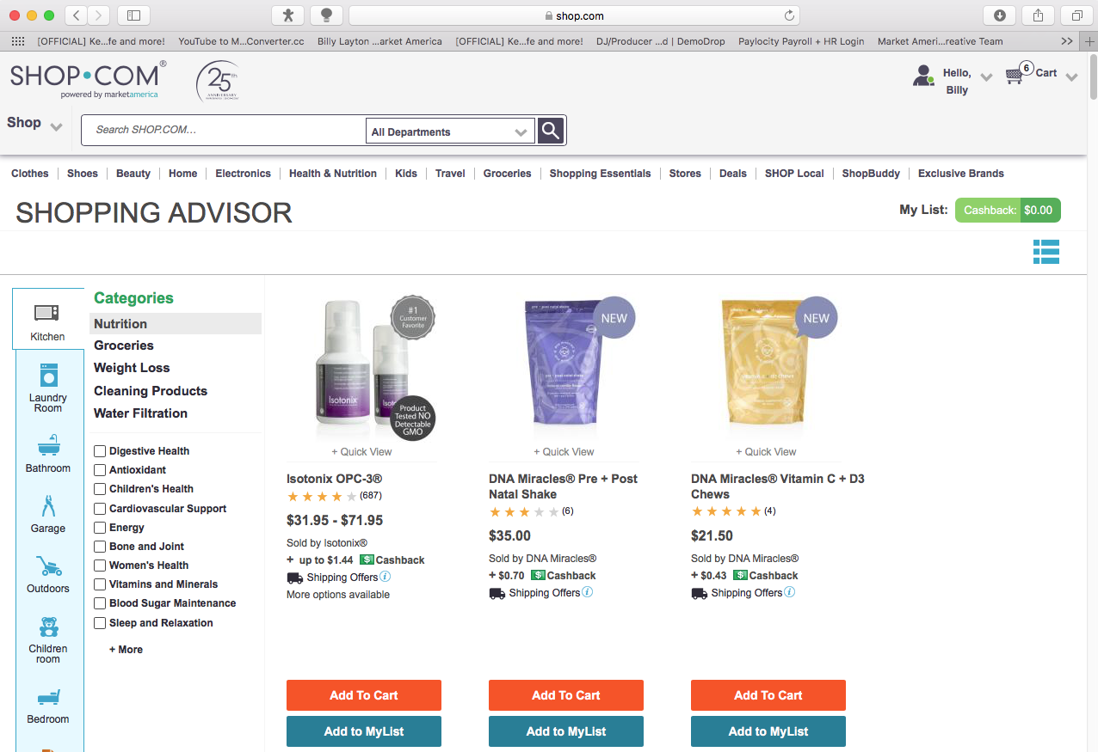
PLAY 1戰術1
90 Days to transfer 150-250 BV from “Other Brands” to YOUR BRAND
透過將「其他品牌」轉換成你的品牌，
在90天內賺取150-250 BV
Use Consistently & Correctly Fast Start Kit products
持續正確使用「新人快速啟動組合」產品
Complete Home Shopping List
完成「居家購物清單」
Look Up BV Values for ma Branded products checked off
逐一查看美安獨家品牌產品的業績點數(BV)
Revise Transfer Buying Order* before first pull if needed
如有需要需要，請在啓動自動購貨計劃前修改自動購貨訂單*

Slide 3
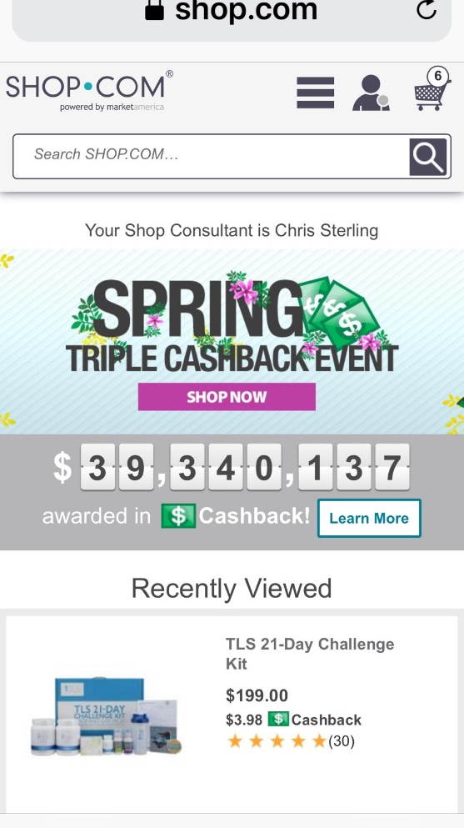
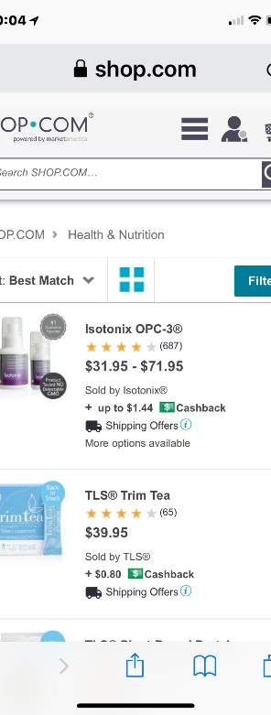
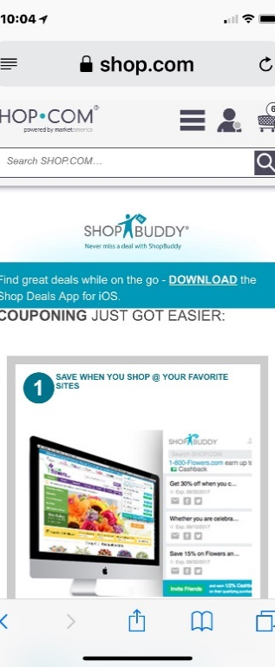
Change how you buy, and where you buy...
改變你的 購物方式和購物地點...
SHOP.COM/??? PCID & PSWD on “Every Computer”
在「自己的每一台電腦」上儲存你的SHOP.COM網站優惠顧客編號與密碼
“Surf” SHOP.COM site
「瀏覽」 SHOP.COM網站
Conduct inventory of “Stores” you currently buy from
檢視你目前消費的「店家」
Install “Shop Buddy”
安裝「Shop Buddy」
“What you are going to buy anyway!”
「你無論如何都要購買的必需品！」

Slide 4

Create Possibility List 60-300 Names & Contact Info. in first 10 days
在最初的十天內建立一份有60-300位潛在顧客姓名及其聯絡資料的名單
Address Book
Contact from Phone
Facebook
Instagram
Twitter...etc
Who do you know that...
通訊錄
來自電話的聯絡人
Facebook
Instagram
Twitter...等
你還認識誰...

Slide 5

Sell 100 BV in “New Product” / month for the first 12 months
在前12個月，每個月銷售100 BV的「新產品」
Talk/converse with 16 Possibilities/Names per month
每個月與16名潛在顧客交談
Ask questions/probe for problems or challenges
藉由發問找出他們所面對的問題或難題
Listen...for product solutions
仔細聆聽...找出產品對策
Use testimonials/success to create new sales
利用成功經驗分享，增加新的銷售機會
Complete HSL with ALL customers
與所有顧客完成居家購物清單
PLAY 4戰術4

Slide 6

Show Business Plan to ≥ 4 Qualified Possibilities per month
每個月至少向四名合格的潛在顧客展示你的事業計劃
Talk/converse with 16 Possibilities/Names per month
每個月與16名潛在顧客交談
Ask questions/probe for problems or challenges
藉由發問找出他們所面對的問題或難題
Listen...for financial solutions
仔細聆聽...找出理財對策
Use testimonials/success to create interest
利用成功經驗分享，吸引對方產生興趣
Use UBP Video...(3 parts)
利用超連鎖事業說明會(UBP)影片…（共三個部分）
Complete HSL after video and register as PC
影片結束之後完成家居購物清單，並註冊成為優惠顧客
PLAY 5戰術5

Slide 7

Training in first 90 days
前90天訓練
Online NEW UNFRANCHISE OWNER TRAINING (NUOT) ≤ 30 days
在加入的前30天內參加新超連鎖店主訓練(NUOT)
Online BASIC FIVE TRAINING (B5) ≤ 60 days
在加入的前60天內參加成功五要訣線上訓練(B5)
Live!...NDT
再參加新超連鎖店主訓練(NUOT)
Live!...B5
再參加成功五要訣訓練(B5)
Executive Coordinator Certification Training (ECCT)
授證經理級訓練(ECCT)
Attend Local Seminar...Buy 3 Tickets
出席地方研討會...購買三張門票
PLAY 6戰術6

Slide 8

THIS IS A PART-TIME BUSINESS
這是一份可兼職的事業
NOT A SPARE TIME BUSINESS
而非隨性的兼職

Slide 9

SET THE NEW UFO’S CALENDAR
設定新超連鎖店主的行事曆
WHEN ARE THEY GOING TO WORK?
他們甚麼時候開始工作？

Slide 10

BUILDING A LEG建立組織
POWER OF LEVERAGE借力使力的力量
Do you want to make HK$1,500/week FAST?
你想每週快速賺取HK$1,500嗎？
OR或
Do you want to make HK$300 check FASTER?
你想更快賺取一筆HK$300的支票嗎？

Slide 11

Strategic numbers
策略數據
150-250 BV/Month Personal Use
每月個人使用達到150-250 BV
60 – 300 Names for “Possibility List”
「潛在人選名單」有60-300個人選
Sell 100 BV (New Business) per month first 12 month in business
事業初始的12個月，每月銷售100 BV（新業績）
Show Plan to 4 qualified individuals per month
每月向四位合格人選展示事業計劃

Slide 12

Reviewing and Grouping Possibilities to Build Teams
逐一檢視潛在人選，評估之後組成團隊
NAME (XBA) 姓名(XBA)
NAME (XBA) 姓名(XBA)
NAME (XBA) 姓名(XBA)
NAME (XA) 姓名(XA)
NAME (XA) 姓名(XA)
NAME (XA) 姓名(XA)
NAME (XA) 姓名(XA)
NAME (X) 姓名(X)
NAME (X) 姓名(X)
NAME (X) 姓名(X)
Key Groupings:
組隊關鍵：
X = All Your Possibilities
X = 你的全部的潛在人選
A = Friends/Family
A = 親朋好友
B = Work
B = 同事

Slide 13
Reviewing and Grouping Possibilities to Build Teams
逐一檢視潛在人選，評估之後組成團隊
B
X
X
B
X
X
X
B
X
B
YOU
你
B
X
B
A
X
B
X
B
X
X
A
A
A
X
B
X
A
B
B
X
A
B
X = Your Possibilities
X = 你的全部的潛在人選
A = Friends/Family
A = 親朋好友
B = Work
B = 同事
X
A
A
X
A
A
A
A
A
A
A

Slide 14

Team building and
placement strategy
團隊發展與
放置位置策略
YOU
你
XA
X
XA
X
XB
X
XB
X
XA
Maintain vested economic interest in the success of each within the grouping they originated from on your Possibilities List
確保可藉由來自潛在人選名單中同組的每位夥伴的成功獲得相應經濟利益
Key Groupings:
組隊關鍵：
X = All Your Possibilities
X = 你的全部的潛在人選
A = Friends/Family
A = 親朋好友
B = Work
B = 同事
XB
XA

Slide 15
COMBINATIONS
結合團隊
Team building and
placement strategy
團隊發展與
放置位置策略
YOU
你
XA
X
XA
X
XB
X
XB
X
XA
Bring New Person to Follow – Up
帶領新人一起做跟進追蹤
Key Groupings:
組隊關鍵：
X = All Your Possibilities
X = 你的全部的潛在人選
A = Friends/Family
A = 親朋好友
B = Work
B = 同事
XB
Home Business
Presentation
家庭事業
說明會
XA
Outcome: You are working two organizations in one night!
結果：你在一夜之間經營兩個組織！

Slide 16
ABC Pattern of Duplication & Building Depth
複製與深層建構的ABC跟進法
SENIOR PARTNER
資深夥伴
YOU
你
A
A
B
B
C
C
A1
A1
B1
B1
C1
C1
A2
A, B, C, etc. are Go NOW UnFranchise Owners
A、B、C等均為積極進取型超連鎖店主
B2
C2

Slide 17

30% retail profit on sale of MA Branded Products
銷售美安品牌產品可賺取30%零售利潤
HK$100 retail sales of MA Branded Products = HK$30 profit
HK$100美安品牌產品的零售 = HK$30的利潤
HK$100 retail sales of MA Branded Products = 50 BV
HK$100美安品牌產品的零售 = 50 BV
HK$200 retail Sales/month = 100BV
每月零售額HK$200 = 100BV
HK$200 retail Sales/month = HK$60 profit
每月零售額HK$200 = HK$60的利潤
Assumptions for Creating
a Team Plan of Action
制定
團隊行動計劃的設想

Slide 18

Assumptions for Creating a Team Plan of Action
制定團隊行動計劃的設想
50% or more clients will be repeat buyers monthly
每個月會有50%以上的顧客會回購
HK$200 retail Sales (New Business) x 12 months = HK$2,400 (New Business)/month
HK$200的零售額（新業績）x 12個月 = 每個月HK$2,400（新業績）
HK$2,400 (New Business) x 50% = HK$1,200 (Repeat Business)/month
HK$2,400（新業績）x 50% = 每個月HK$1,200（來自顧客回購的業績）
HK$1,200 (Repeat Business) month = 600 BV (Repeat Business)/month
每個月HK$1,200（回購業績）= 每個月600 BV（來自顧客回購的業績）
HK$1,200 (Repeat Business) month = HK$360 Repeat Profit
每個月$1,200（回購業績）= $360的重覆性利潤
  Two (2) teams of UnFranchise® Owners each generating 5,000 BV results in HK$1,500 in commissions
  兩(2)個超連鎖店主團隊各創造5,000 BV，一起賺取HK$1,500的佣金

Slide 19

Assumptions for Creating a Team Plan of Action
制定團隊行動計劃的設想
  Each UnFrachise® Owner (Team Member) commits to use 150 – 250 BV / month
  每位超連鎖店主（團隊夥伴）承諾每月使用150-250 BV的產品
  Each UnFranchise® Owner (Team Member) commits to selling HK$200 at retail / month = HK$60 retail profit and 100 BV/month of new business FIRST 12 MONTHS IN BUSINESS
  每位超連鎖店主（團隊夥伴）承諾每月零售額達到HK$200 = 每月HK$60的零售利潤與每月100 BV的新業績事業初始的12個月
  Each UnFranchise® Owner (Team Member) commits to exposing the Business Plan to four (4) qualified individuals per month
  每位超連鎖店主（團隊夥伴）承諾每個月向四位合格人選展示事業計劃
  Registration ratio of 8:1
  加入比例為8:1

Slide 20














ASSUMPTIONS FOR CREATING THE TEAM’S PLAN OF ACTION
制定團隊行動計劃的設想
Team growth based on 8:1 ratio
基於8:1比例的團隊成長

Slide 21

ASSUMPTIONS FOR CREATING THE TEAM’S PLAN OF ACTION
制定團隊行動計劃的設想
Team growth based on 8:1 ratio
基於8:1比例的團隊成長
Each UFO=
每位超連鎖店主 =
• 300 – 600 BV Initial
初始300-600 BV
• 150 – 250 BV/Month Personal Use
每個月150-250 BV的個人使用
• 100 – 600 BV/Month
每個月100-600 BV

Slide 22

INITIAL RETAIL SALES GOAL 初始零售目標
MONTHLY GOAL FOR NEW UNFRANCHISE® OWNER IS TO GENERATE 200 BV AND 20 IBV FROM PERSONAL USE AND 300 BV AND 200 IBV TO A BASE OF AT LEAST 10 PREFERRED CUSTOMERS ORDERING 30 BV AND 20 IBV PER MONTH
新超連鎖店主的每月目標為從個人消費產生200 BV及20 IBV，
並擁有至少10名優惠顧客，其中每人每月購買30 BV及20 IBV，產生300 BV及200 IBV
PC 優惠顧客-
PC 優惠顧客-
PC 優惠顧客-
PC 優惠顧客-
PC 優惠顧客-
- PC 優惠顧客
- PC 優惠顧客
- PC 優惠顧客
- PC 優惠顧客
- PC 優惠顧客
  PC = 30 BV AND 20 IBV 優惠顧客 = 30 BV及20 IBV
  TOTAL UNFRANCHISE OWNER PRODUCTION:
  500 BV AND 220 IBV
  每位超連鎖店主共產生：
  500 BV及220 IBV

Slide 23
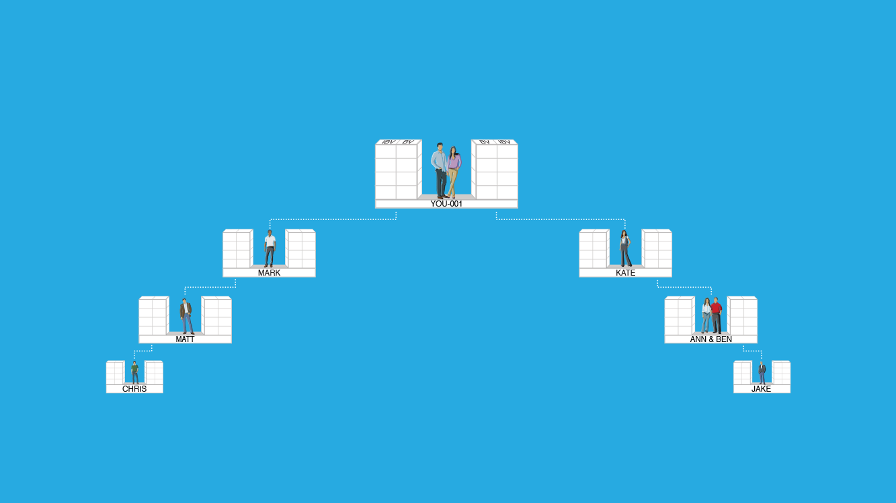
RETAIL SALES GOAL - BASE 10, SEVEN STRONG
零售目標 — 基本十顧客，七人強
SEVEN UFOS WITH 10 PCS EACH 7位超連鎖店主，每位擁有10名優惠顧客
Each UFO creates 500 BV and 200 IBV Monthly (Personal Use and PCs)
每位超連鎖店主每月產生500 BV及200 IBV（個人消費及優惠顧客群）
Commissions = HK$2,300 ($300)/Monthly (BV) and HK$2,300 ($300) every 2nd month (IBV)
佣金 = HK$2,300 ($300)/每月(BV)及HK$2,300 ($300)/每兩個月(IBV)
1500 BV & 600 IBV
1500 BV & 600 IBV
5 PCs
5 PCs
500 BV & 200 IBV
Volume can be placed
點數可被放置
5 PCs
5 PCs
5 PCs
5 PCs
500 BV & 200 IBV
500 BV & 200 IBV
5 PCs
5 PCs
5 PCs
5 PCs
500 BV & 200 IBV
500 BV & 200 IBV
5 PCs
5 PCs
5 PCs
5 PCs
500 BV & 200 IBV
500 BV & 200 IBV
BV and IBV banks on this slide display weekly volume accruals
這張投影片顯示BV及IBV每週點數累積情況

Slide 24


Minimum Activity 最低限度的活動
  50 BV and 10 IBV monthly per UFO 每位超連鎖店主每月50 BV及10 IBV
Power of Your Actions
行動的力量
Monthly Goal and Base 10
每月目標與基本10顧客
  200 BV and 20 IBV monthly per UFO 每位超連鎖店主每月200 BV及20 IBV
  300 BV and 200 IBV to 10 Preferred Customers per UFO (30/20 each) 每位超連鎖店主的10名優惠顧客300 BV及200 IBV（每人30/20）
Shopping Annuity® and Base 10
購物年金及基本10顧客
  500 BV and 200 IBV monthly per UFO 每位超連鎖店主每月500 BV及200 IBV
  300 BV and 200 IBV to 10 Preferred Customers per UFO (30/20 each) 每位超連鎖店主的10名優惠顧客300 BV及200 IBV（每人30/20）

Slide 25
ORGANIZATION SATISFYING THE MINIMUM ACTIVITY REQUIREMENTS
組織達到最低活動要求
Commissions = HK$4,600 ($600) monthly (BV) and HK$2,300 ($300) every quarter (IBV)
佣金 = HK$4,600 ($600) /每月(BV) 及HK$2,300 ($300)/每季度(IBV)
Minimum Activity Requirements 最低活動要求
50 BV + 10 IBV monthly per UFO
Total = 50 BV + 10 IBV per UFO
每位超連鎖店主每月50 BV + 10 IBV
總計 = 每位超連鎖店主50 BV + 10 IBV
You should earn HK$2,300-HK$4,600 ($300 - $600) every two weeks (BV) and HK$2,300 ($300) quarterly (IBV)
你可每兩週賺取HK$2,300-HK$4,600 ($300 - $600) (BV)及每季度賺取HK$2,300 ($300) (IBV)
50 UFO’s x 50 BV = 2,500 BV Monthly
50超連鎖店主 x 50 BV = 每月2,500 BV
50 UFO’s x 10 IBV = 500 IBV Monthly
50超連鎖店主 x 10 IBV = 每月500 IBV
50 UFO’s x 10 IBV = 500 IBV Monthly
50超連鎖店主 x 10 IBV = 每月500 IBV
50 UFO’s x 50 BV = 2,500 BV Monthly
50超連鎖店主 x 50 BV = 每月2,500 BV
BV and IBV banks on this slide display weekly volume accruals
這張投影片顯示BV及IBV每週點數累積情況

Slide 26

ORGANIZATION SATISFYING THE MONTHLY GOAL AND BASE 10 組織達到每月目標及基本10顧客
Commissions = HK$46,000 ($6,000) monthly (BV) and HK$23,000 ($3,000) monthly (IBV)
佣金 = 每月HK$46,000 ($6,000) (BV) 及每月HK$23,000 ($3,000) (IBV)
Monthly Goal 每月目標
200 BV + 20 IBV monthly per UFO
每位超連鎖店主每月200 BV + 20 IBV
Base 10 基本10顧客
300 BV + 200 IBV from 10 PCs per UFO
Total = 500 BV + 220 IBV per UFO
每位超連鎖店主的10名優惠顧客300 BV + 200 IBV
總計 = 每位超連鎖店主500 BV + 220 IBV
You should earn HK$11,500 ($1500) weekly (BV) and HK$11,500 ($1500) every 2 weeks (IBV)
你可每週賺取HK$11,500 ($1500) (BV) 及每兩週賺取HK$11,500 ($1500) (IBV)
50 UFO’s x 500 BV = 25,000 BV Monthly
50超連鎖店主 x 500 BV = 每月25,000 BV
50 UFO’s x 200 IBV = 10,000 IBV Monthly
50超連鎖店主 x 200 IBV = 每月10,000 IBV
50 UFO’s x 200 IBV = 10,000 IBV Monthly
50超連鎖店主 x 200 IBV = 每月10,000 IBV
50 UFO’s x 500 BV = 25,000 BV Monthly
50超連鎖店主 x 500 BV = 每月25,000 BV
BV and IBV banks on this slide display weekly volume accruals
這張投影片顯示BV及IBV每週點數累積情況

Slide 27
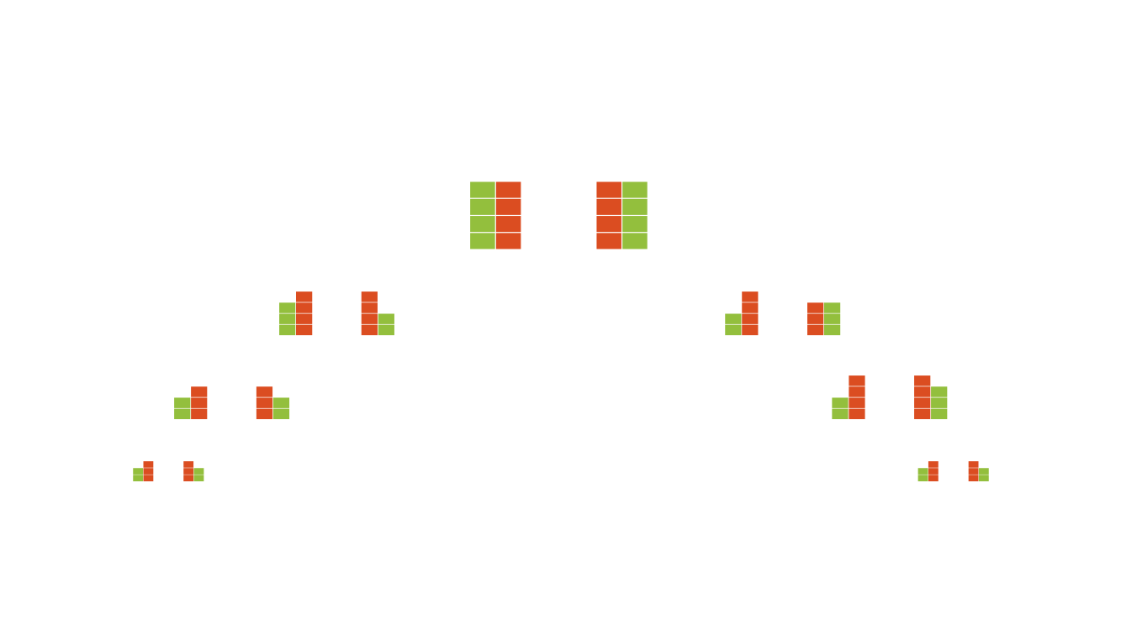
ORGANIZATION SATISFYING THE SHOPPING ANNUITY® AND BASE 10
組織達到購物年金及基本10顧客要求
Commissions = HK$64,400 ($8,400) monthly (BV) and HK$46,000 ($6,000) monthly (IBV)
佣金 = 每月HK$64,400 ($8,400) (BV) 及每月HK$46,000 ($6,000) (IBV)
Shopping Annuity 購物年金
500 BV + 200 IBV monthly per UFO
每位超連鎖店主每月500 BV + 200 IBV
Base 10 基本10顧客
300 BV + 200 IBV from 10 PCs per UFO
Total = 800 BV + 400 IBV per UFO
每位超連鎖店主的10名優惠顧客300 BV + 200 IBV
總計 = 每位超連鎖店主800 BV + 400 IBV
You should earn HK$16,100 ($2100) weekly (BV) and HK$11,500 ($1500) weekly (IBV)
你可每週賺取HK$16,100 ($2100) (BV) 及每週賺取HK$11,500 ($1500) (IBV)
50 UFO’s x 800 BV = 40,000 BV Monthly
50超連鎖店主 x 800 BV = 每月40,000 BV
50 UFO’s x 400 IBV = 20,000 IBV Monthly
50超連鎖店主 x 400 IBV = 每月20,000 IBV
50 UFO’s x 400 IBV = 20,000 IBV Monthly
50超連鎖店主 x 400 IBV = 每月20,000 IBV
50 UFO’s x 800 BV = 40,000 BV Monthly
50超連鎖店主 x 800 BV = 每月40,000 BV
BV and IBV banks on this slide display weekly volume accruals
這張投影片顯示BV及IBV每週點數累積情況

Slide 28
Minimum Activity 最低限度的活動
Power of Your Actions
行動的力量
  HK$5,370 ($700) average monthly commissions
  平均每月HK$5,370 ($700)的佣金收入
Monthly Goal and Base 10
每月目標與基本10顧客
  HK$69,000 ($9,000) average monthly commissions
  平均每月HK$69,000 ($9,000)的佣金收入
Shopping Annuity and Base 10
購物年金及基本10顧客
  HK$110,400 ($14,400) average monthly commissions
  平均每月HK$110,400 ($14,400)的佣金收入

Slide 29


Achieve your goals
達成你的目標
By solely relying on your efforts and results
單靠你一個人的努力與成果
OR
或是
By building two (2) teams of
UnFranchise® Owners
藉由打造兩(2)個超連鎖店主團隊

Slide 30

YOU NEED TO TAKE FULL RESPONSIBILITY FOR YOUR OWN SUCCESS.
你必須為自己的成功負起全部的責任。
THIS IS YOUR BUSINESS AND YOUR INCOME!
這是你自己的事業和收入！

Slide 31

YOU CAN’T PUT YOUR MA UNFRANCHISE BUSINESS 2ND, 3RD OR 4TH ON THE PRIORITY LIST AND EXPECT IT TO PAY YOU 1ST!!
你無法將自己的超連鎖事業列為第二、第三或第四順位，而期望它能為你賺取第一收入！

